Slide 1
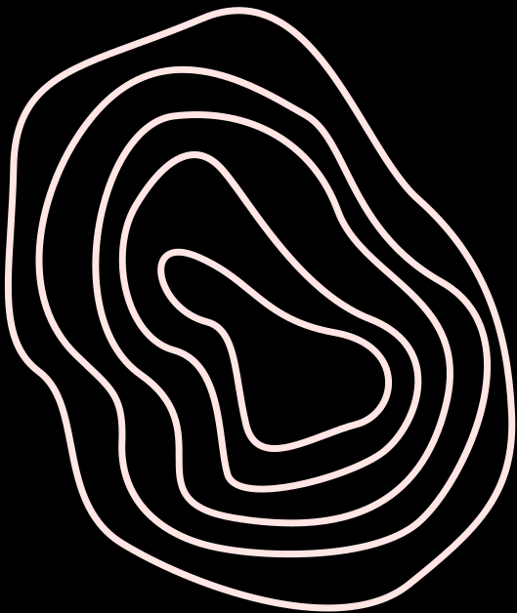
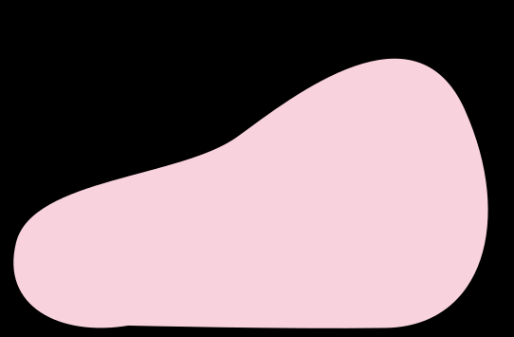






GROUP PROJECT
Riya Shah, Tasnim Amara, Emaan Anwar, Simar Sabharwal

Slide 2
PROBLEM STATEMENT
Severe flooding has isolated two remote communities, cutting off access to food, medical supplies, and emergency aid. Rising water levels, debris, and damaged terrain have made ground transport unusable.
To restore support, a small-scale rescue vehicle must reliably navigate floodwaters, withstand currents and obstacles, and deliver essential aid to both communities. Reaching these locations safely, without sinking or damaging the cargo, represents the core engineering challenge of this problem.

Slide 3
OUR GOALS
Ensure the size fits the 13 by 13 constraints
Try having a budget under $1000
Try to get our prototype from the first destination to the second with no interference in between
Use two different propeller system

Slide 4
TIMELINE GOALS
10:00 Get the sketch ready
11:00 Finish the materials list and budget
12:00 Compile the materials and start building it
1:00 - focus on the propellers, the and the base of the prototype
2:00- focus on the balloon mechanism, and ramps of the prototype
2:30- Run tests and readjust the prototype if needed
2:50 - Submit

Slide 5
MATERIALS AND PRICING
MATERIAL | QUANTITY | COST ($)
BALLOON | 1 | 15
WHEELS | 3 | 150
BAMBOO STICKS | 2 | 20
STRAWS | 8 | 80
CARDBOARD | 10 x 12 cm | 125
THIN NOODLE | 2 | 200
HOT GLUE STICK | 3 | 30
SARAN WRAP | 1 | 15
ELASTIC BANDS | 3 | 105
MATERIAL | QUANTITY | COST ($)
POPSICLE STICKS | 12 | 120
DUCT TAPE | 2 | 150
CARDBOARD | 10X6 | 60
CARDBOARD | 5 x 6 | 30
PIPE CLEANER | 2 | 60
TOTAL |  | 1160
Notes:
The first system is using a balloon as a propeller system. Before launch we tied an inflated balloon to a straw using a rubber band. When we release the system, the air escapes, coming out as a small, steady jet. That jet pushes against the air around it, creating forward thrust. This slow, controlled release gives us gentle propulsion instead of one quick burst. That lets the system stay in motion long enough to deliver the items without any motors or electronics. Once we launch it, the balloon does all the work by converting its stored air pressure into motion

Slide 6
MOVING MECHANISM
To move our device we have decided to use 2 different propeller systems.
1.Balloon propeller
Tied an inflated balloon to a straw using a rubber band
When released, air comes out as a small steady jet
Jet pushes against the air around it, creating forward thrust
Slow controlled release gives gentle propulsion
Stored air pressure is converted to motion
2. Pulley propeller
used a bamboo skewer, and put it through the two carboard pieces standing upright on both sides of the prototype
Created propellers for both sides- by attaching popsickle sticks with glue and duct tape. We designed the way we wanted out propellers to look before hand
used a pipe cleaner to create the hook (at the center of the base)
used the elastic for the pulley system
Assembled everything togther
Notes:
The first system is using a balloon as a propeller system. Before launch we tied an inflated balloon to a straw using a rubber band. When we release the system, the air escapes, coming out as a small, steady jet. That jet pushes against the air around it, creating forward thrust. This slow, controlled release gives us gentle propulsion instead of one quick burst. That lets the system stay in motion long enough to deliver the items without any motors or electronics. Once we launch it, the balloon does all the work by converting its stored air pressure into motion

Slide 7
PROBLEMS WE FACED
Half way through we realized that our prototype doesn’t need to rotate and so after the first drop off it could move sideways towards the second drop off
- Solution: instead of having three wheels, one of which was going to be used to change directions, we used only two, making our prototype more compact
There was an issue with the way the wheels were designed. The length of the popsickle sticks was too long and was interfering with the movement of the protype.
- Solution: cutting the popsickle sticks in half, and slightly changing up the way they were oriented
Notes:
The first system is using a balloon as a propeller system. Before launch we tied an inflated balloon to a straw using a rubber band. When we release the system, the air escapes, coming out as a small, steady jet. That jet pushes against the air around it, creating forward thrust. This slow, controlled release gives us gentle propulsion instead of one quick burst. That lets the system stay in motion long enough to deliver the items without any motors or electronics. Once we launch it, the balloon does all the work by converting its stored air pressure into motion

Slide 8
ORGANIZATION SKILLS
all had assigned roles
had a timetable to ensure we were on time with all tasks - problem faced as we were behind schedule
we all decided our goals in the beginning of the task:
- for example, deiciding we want to make our prototype reach both locations with no contact at all between
Documenting all of our process through sketches, pictures, and notes
Notes:
The first system is using a balloon as a propeller system. Before launch we tied an inflated balloon to a straw using a rubber band. When we release the system, the air escapes, coming out as a small, steady jet. That jet pushes against the air around it, creating forward thrust. This slow, controlled release gives us gentle propulsion instead of one quick burst. That lets the system stay in motion long enough to deliver the items without any motors or electronics. Once we launch it, the balloon does all the work by converting its stored air pressure into motion

Slide 9
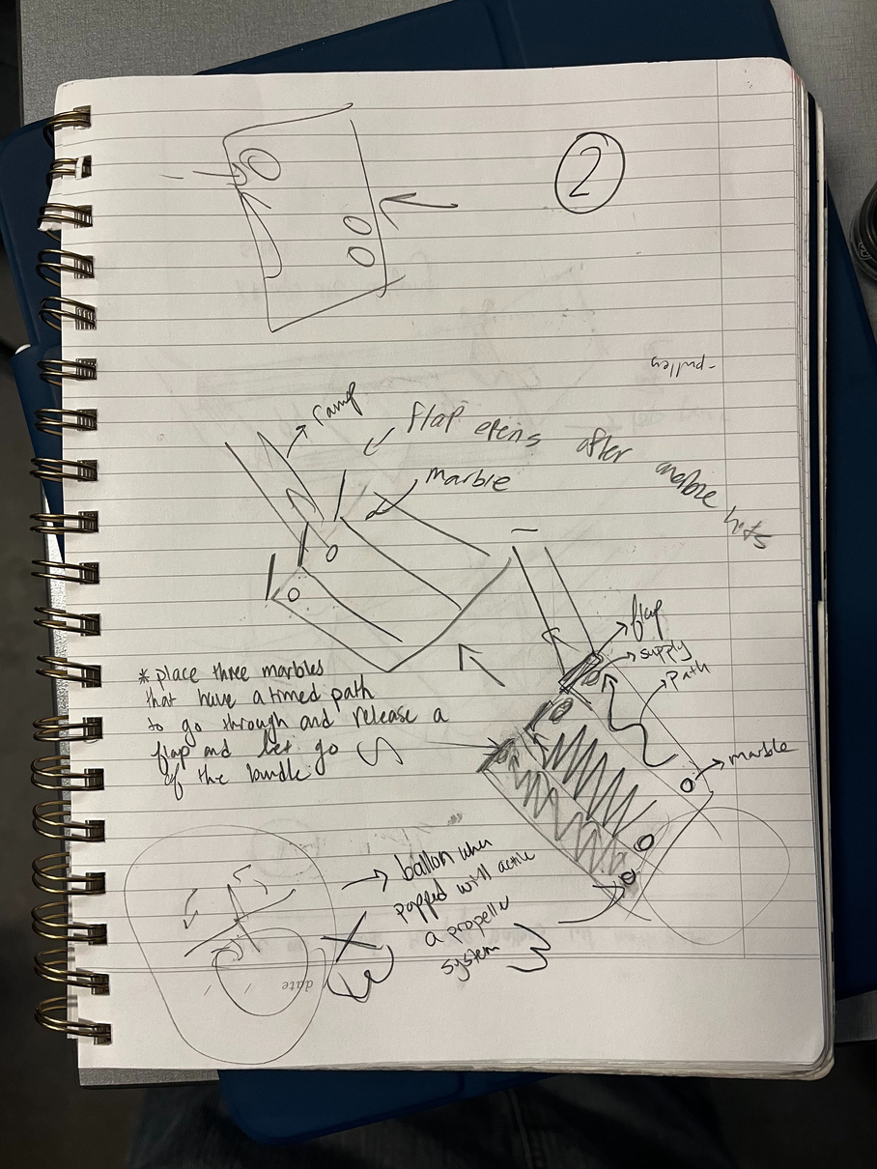
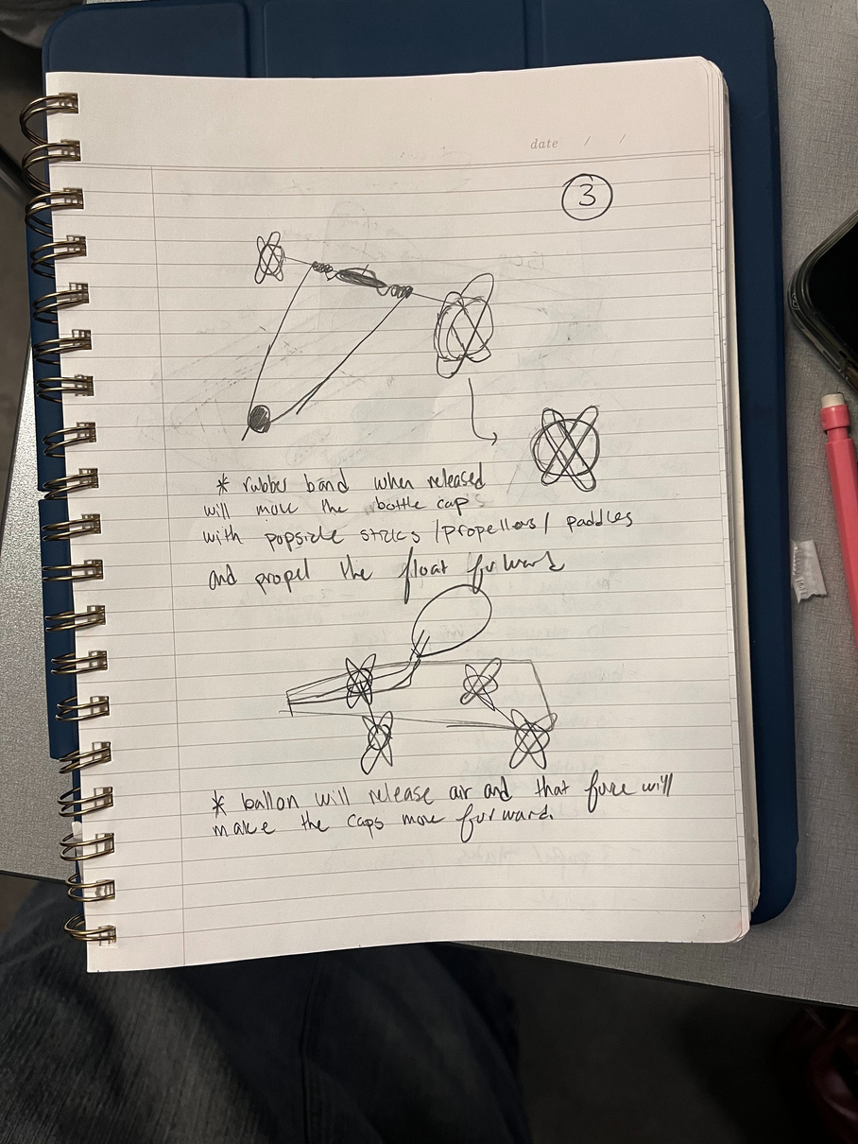
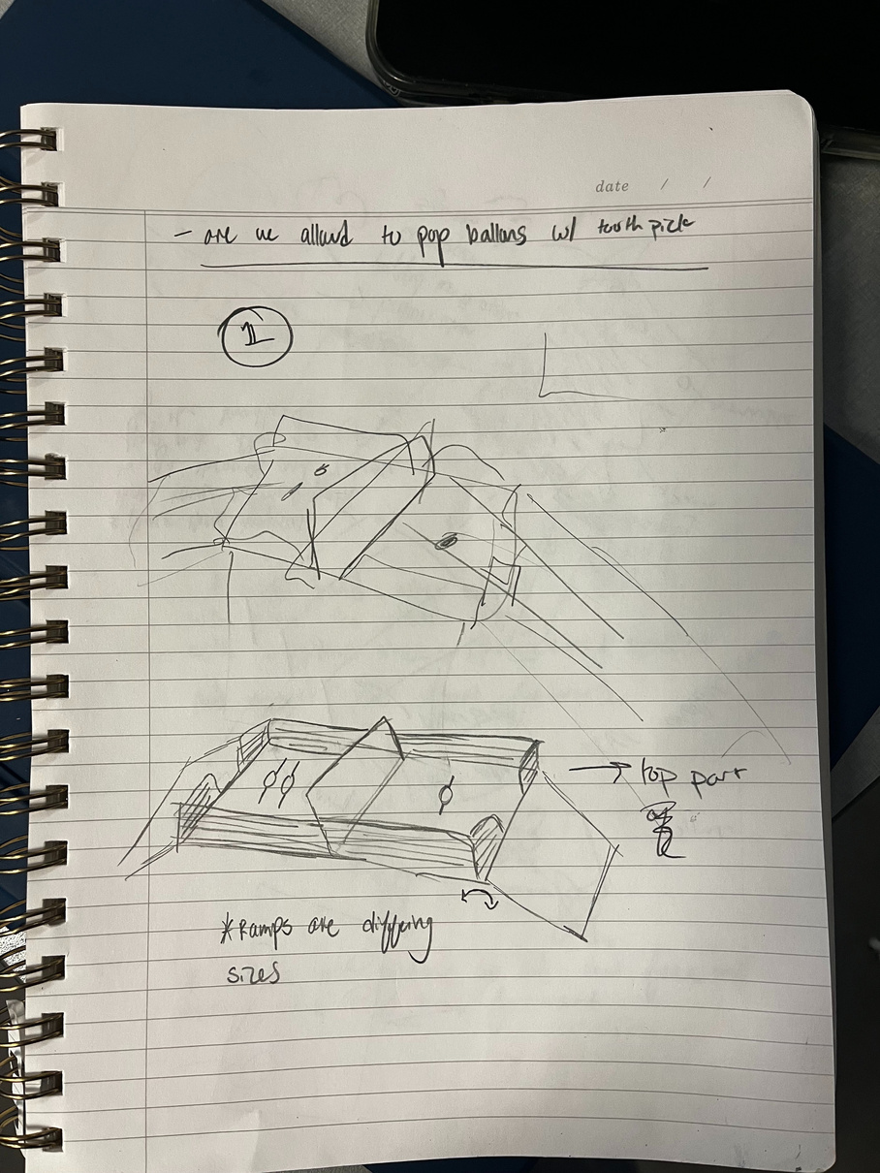
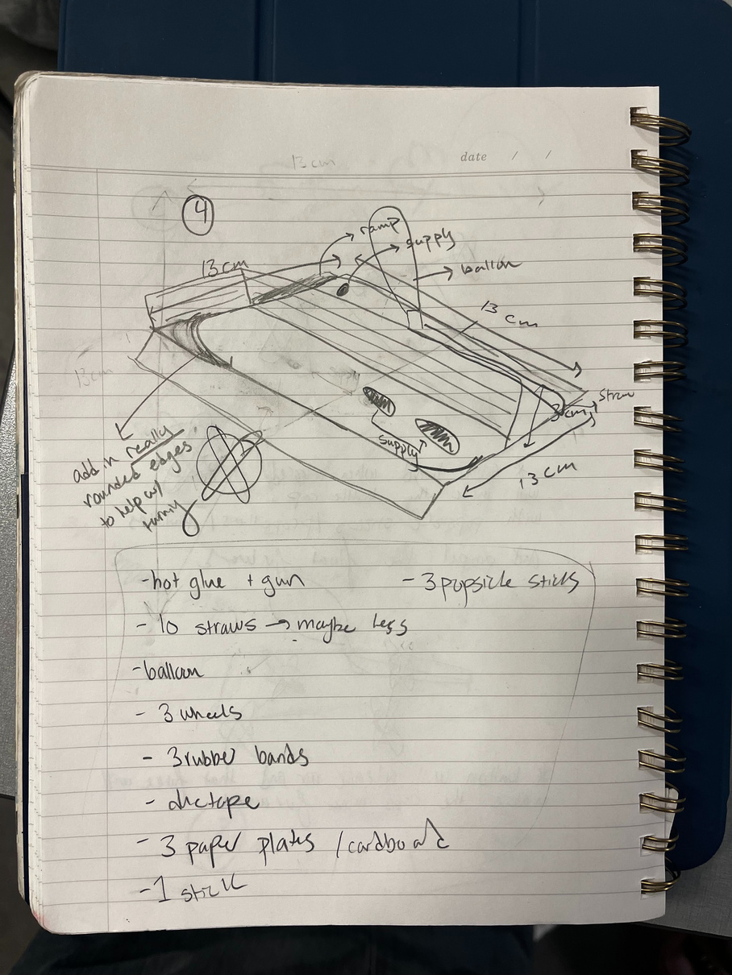
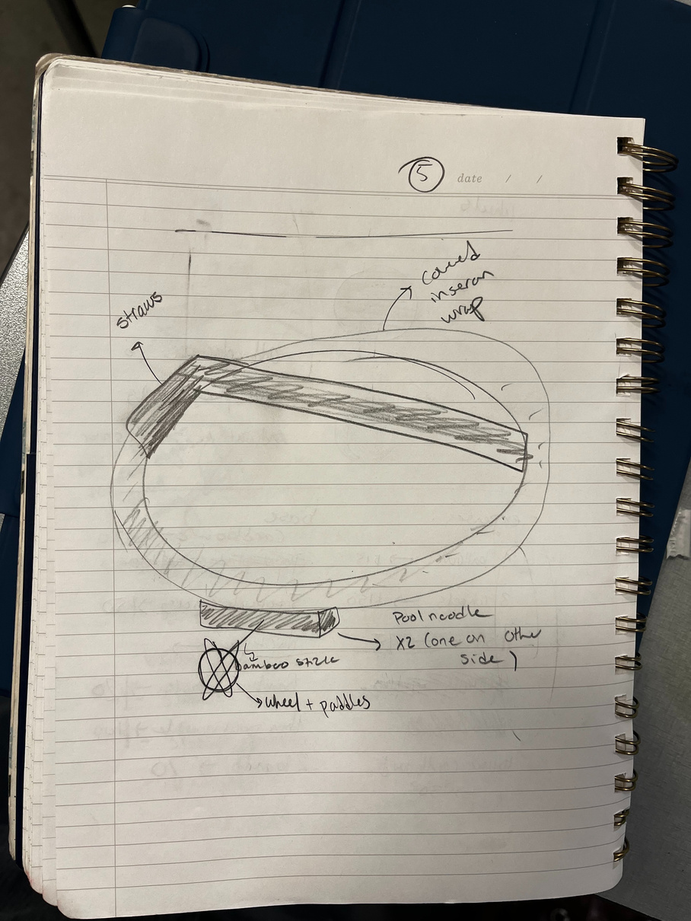
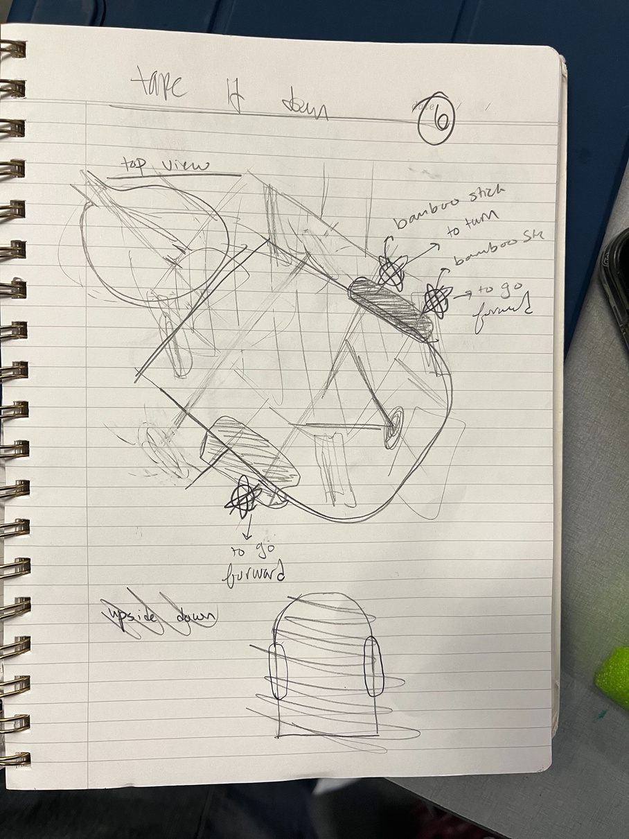
OTHER POSSIBLE DESIGNS WE CONSIDERED

Slide 10
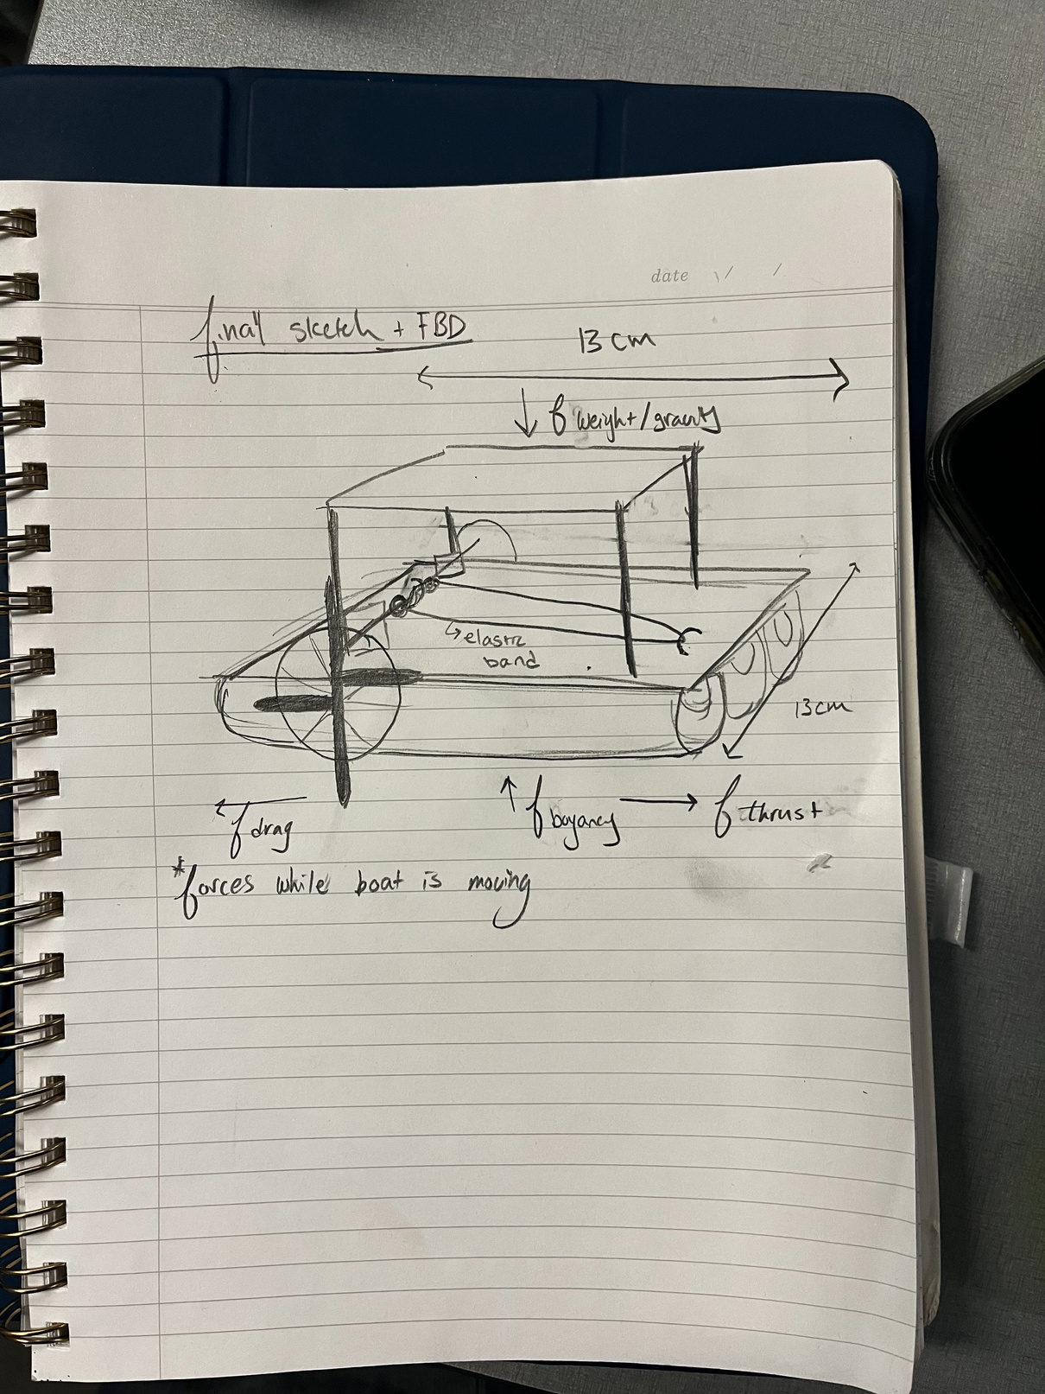
Final Prototype + FBD

Slide 11
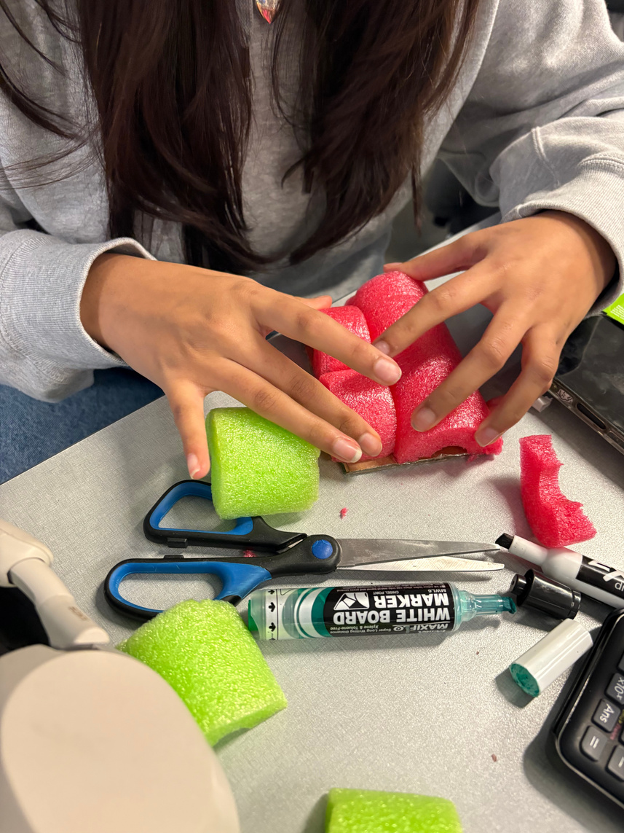
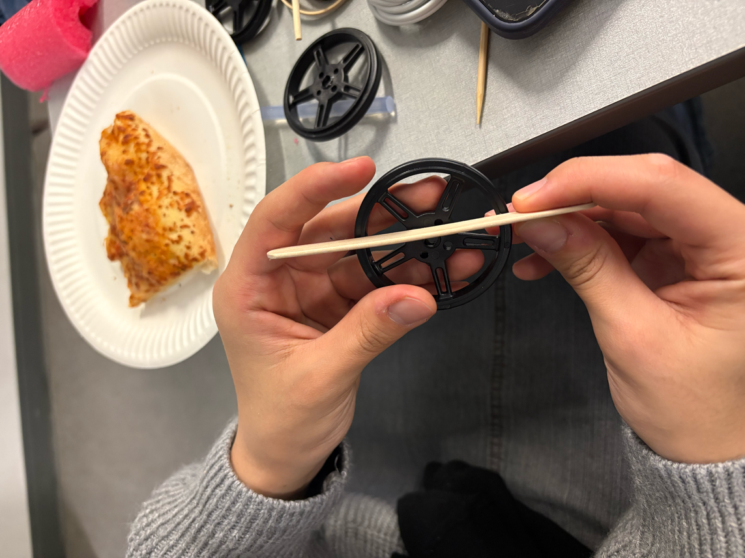
DESIGN PROCESS
Made the base of the prototype and attatched thin noodles to enable it to float
Attatched paddles to the wheels to propel the prototype forward
Made the top half of the prototype by attaching a second card board piece to 4 straws
Used popsicle sticks to make ramps on our prototype using hot glue
5. Put air from the balloon and attached it to prototype as our second mechanical system
6. Ravelled the elastic around the hook to create the pulley system
7. Assembled everything together
8' Tested our prototype

Slide 12
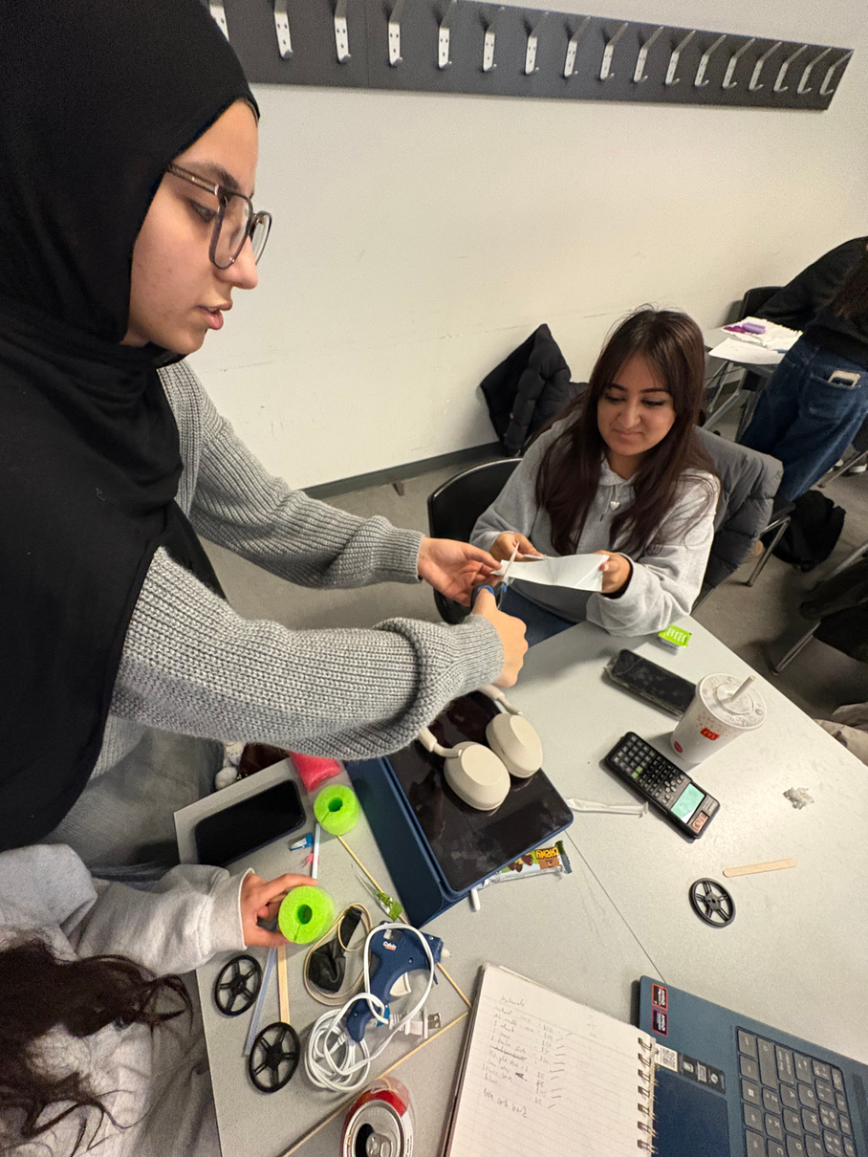
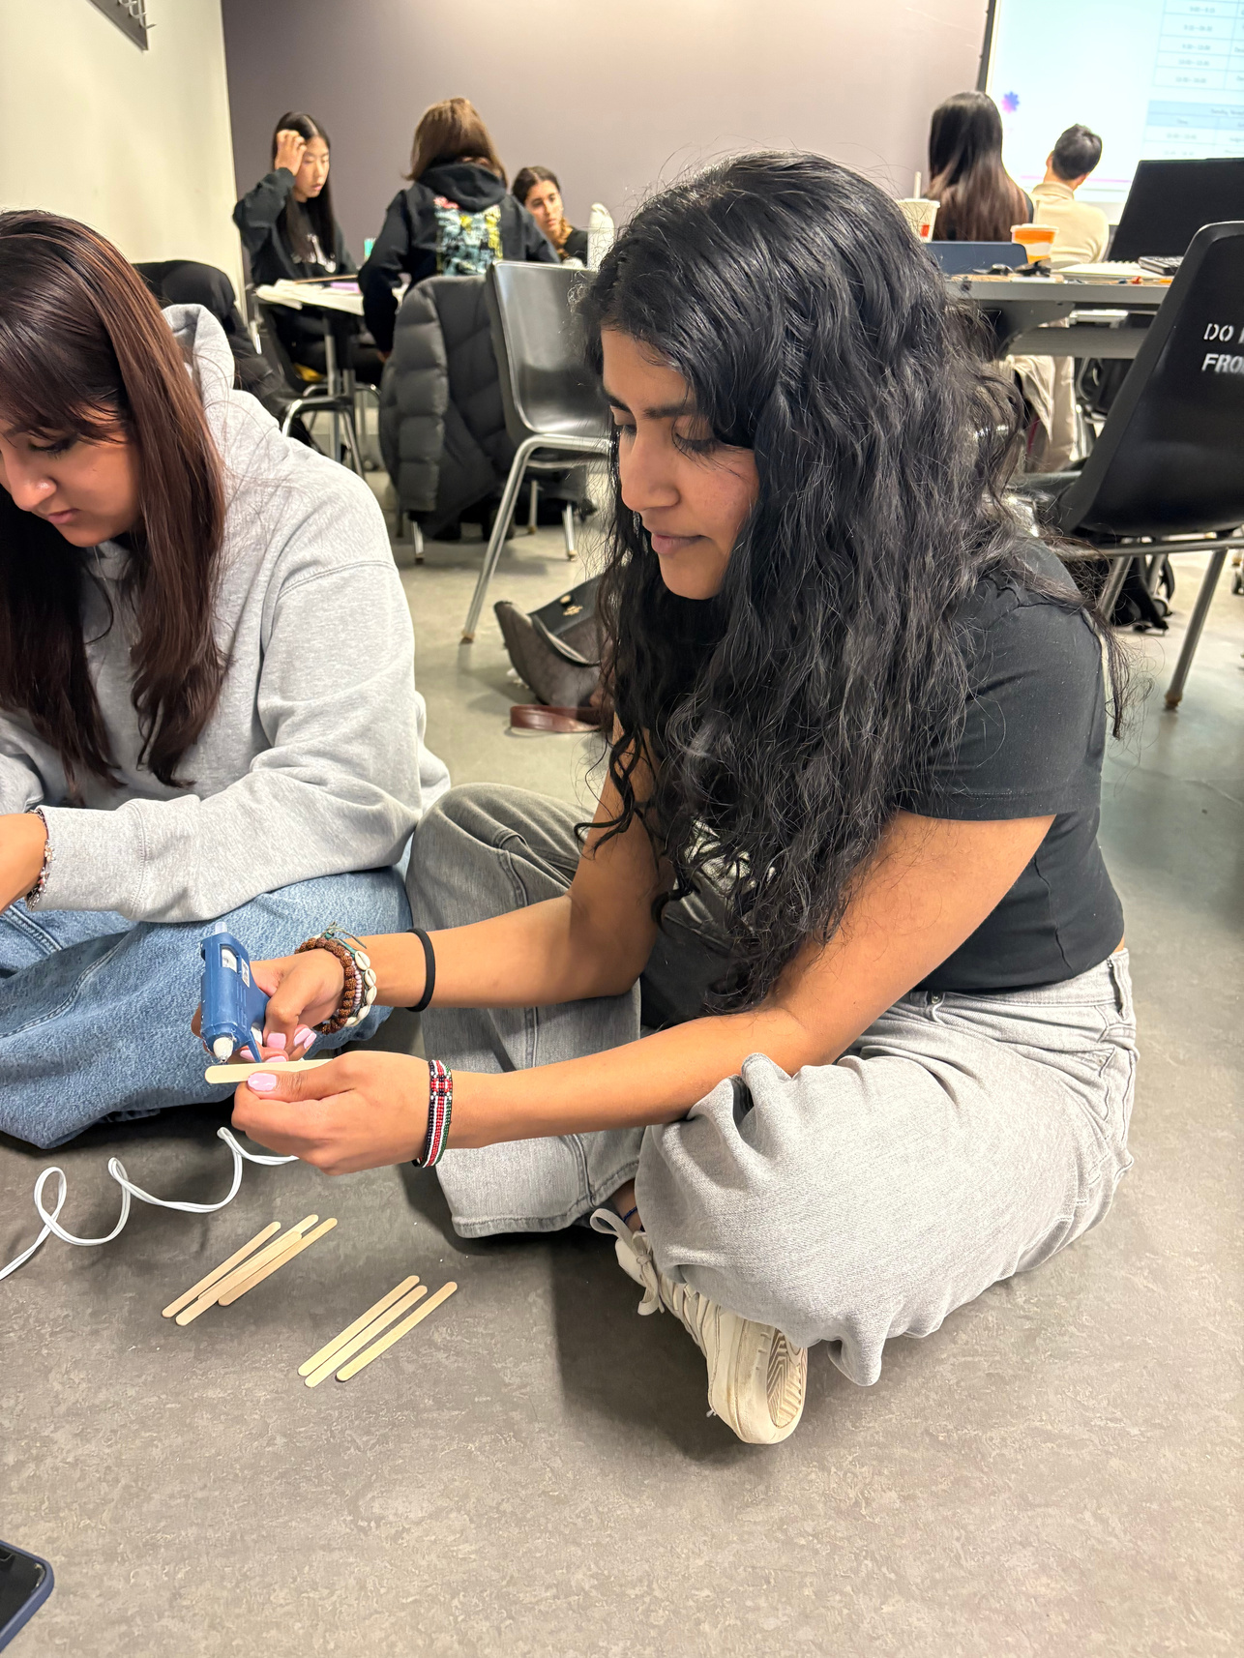
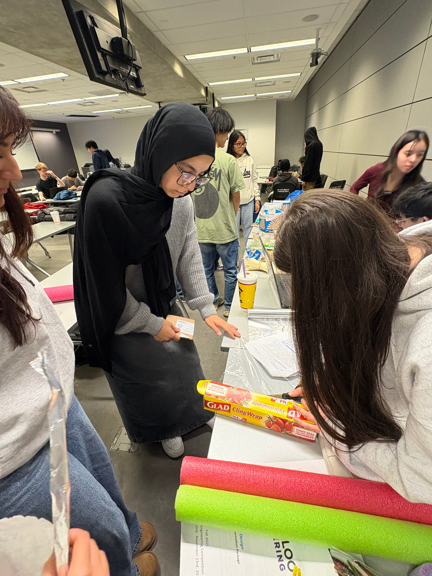
The Process

Slide 13
CONCLUSION
learned teamwork
learned critical thinking skills
enjoyed the experience
learned the design process

Slide 14
THANK
YOU

